Slide 1
Worked Example
PLP with Levinson–Durbin

Slide 2
speech signal
Consider the following short speech sequence: x[n]=[1,2,3,4,2,1,0,-1]
Assume:
Sampling frequency F_{s}=8000Hz
Frame length = 4 samples
No overlap
LPC/PLP order = 2
We will process the first frame.

Slide 3
Step 1: Framing
Step 2: Windowing
The speech signal is divided into frames of 4 samples.
Frame1: x₁​[n]=[1,2,3,4]
Frame2; x₂​[n]=[2,1,0,−1]
For this problem use x₁​[n]=[1,2,3,4]
To keep the numerical example manageable, we assume a rectangular window:
w[n]=1
x_{w}​[n]=x[n]w[n]
therefore
x_{w}​[n] =[1,2,3,4]
In a real PLP system, a Hamming window is normally used.

Slide 4
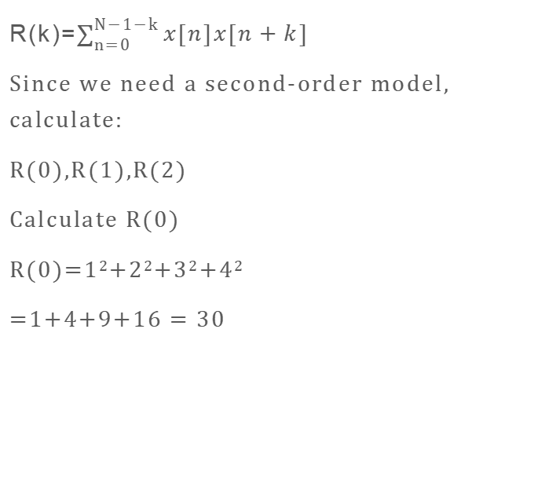
Step 3: Autocorrelation
R(k)=$\sum_{n=0}^{N−1−k}{x[n]x[n+k] }$
Since we need a second-order model, calculate:
R(0),R(1),R(2)
Calculate R(0)
R(0)=1²+2²+3²+4²
=1+4+9+16 = 30
Calculate R(1)
R(1)= (1)(2)+(2)(3)+(3)(4) =2+6+12 $$
R(1)= 20
Calculate R(2)
R(2)= (1)(3)+(2)(4) =3+8
R(2)=11
​
​

Slide 5
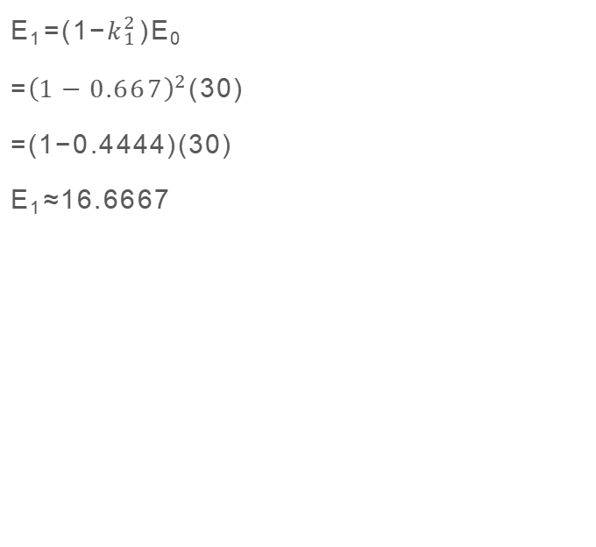
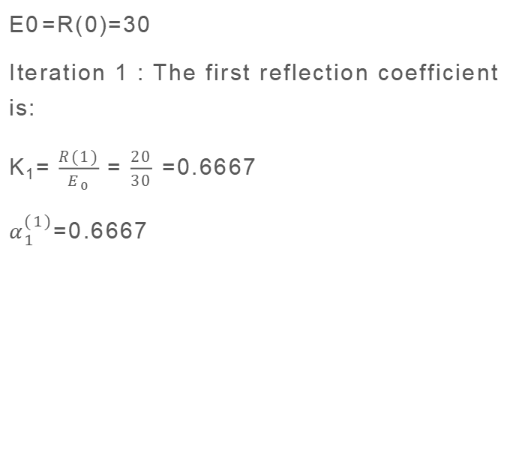
Step 4: Levinson–Durbin Algorithm
E0​=R(0)=30
Iteration 1 : The first reflection coefficient is:
K₁= $\frac{R(1)}{E_{0}}$ = $\frac{20}{30}$​ =0.6667
$α_{1}^{(1)}$=0.6667
​
E₁​=(1−$k_{1}^{2}$​)E_{0​}
=${\left(1−0.667\right)}^{2}$(30)
=(1−0.4444)(30)
E_{1​}≈16.6667​

Slide 6
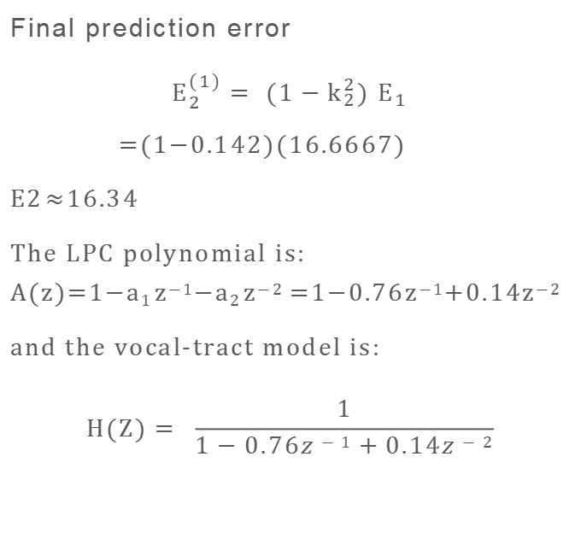
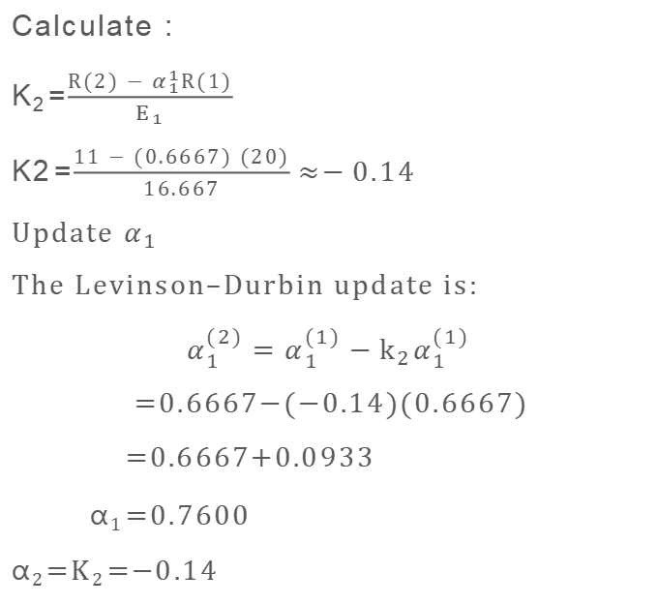
Step 5: Second Levinson–Durbin iteration
Calculate :
K₂​=$\frac{R(2) − α_{1}^{1}R(1)}{E_{1}}$​
K2​=$\frac{11 − (0.6667) (20)}{16.667}≈−0.14$
Update $α_{1}$ ​
The Levinson–Durbin update is:
$$α_{1}^{(2)}=α_{1}^{(1)}−k_{2}α_{1}^{(1)}$$
=0.6667−(−0.14)(0.6667)
=0.6667+0.0933
α₁​=0.7600
α₂​=K₂​=−0.14
Final prediction error
$$E_{2}^{(1)}= (1−k_{2}^{2}) E_{1}$$
=(1−0.142)(16.6667)
E2​≈16.34
The LPC polynomial is: A(z)=1−a₁​z⁻¹−a₂​z⁻² =1−0.76z⁻¹+0.14z⁻²
and the vocal-tract model is:
$$H(Z)= \frac{1}{1−0.76z−1+0.14z−2}$$

Slide 7
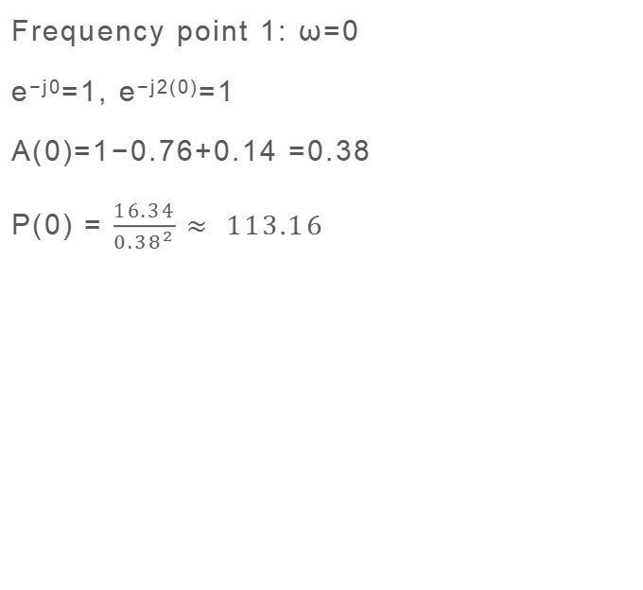
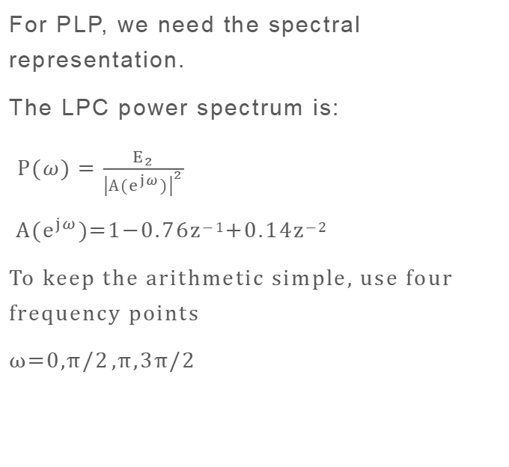
Step 6: Obtain the LPC spectrum
For PLP, we need the spectral representation.
The LPC power spectrum is:
$P(ω)=\frac{E_{2}}{{\left|A(e^{jω})\right|}^{2}}$
$A(e^{jω})$=1−0.76z⁻¹+0.14z⁻²
To keep the arithmetic simple, use four frequency points
ω=0,π/2​,π,3π/2​
Frequency point 1: ω=0
e^{−j0}=1, e^{−j2(0)}=1
A(0)=1−0.76+0.14 =0.38
P(0) = $\frac{16.34}{{0.38}^{2}}$ $≈ 113.16$

Slide 8
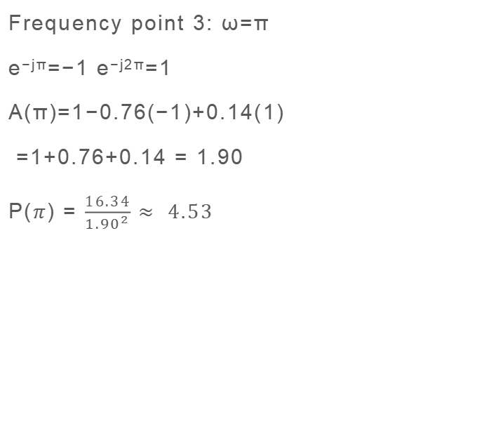
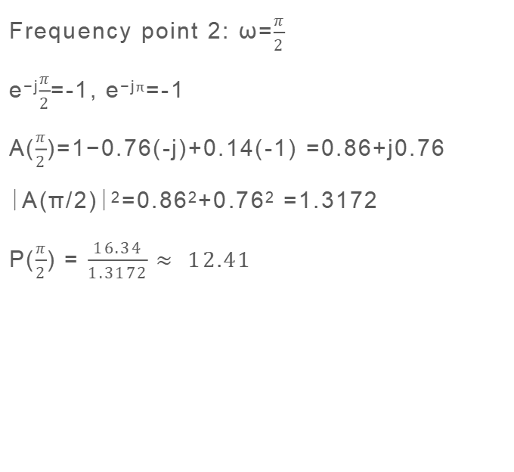
Frequency point 2: ω=$\frac{π}{2}$
e^{−j}$\frac{π}{2}$=-1, e^{−jπ}=-1
A($\frac{π}{2}$)=1−0.76(-j)+0.14(-1) =0.86+j0.76
∣A(π/2)∣²=0.86²+0.76² =1.3172
P($\frac{π}{2}$) = $\frac{16.34}{1.3172}$ $≈ 12.41$
Frequency point 3: ω=π
e^{−jπ}=−1 e^{−j2π}=1
A(π)=1−0.76(−1)+0.14(1)
=1+0.76+0.14 = 1.90
P($π$) = $\frac{16.34}{{1.90}^{2}}$ $≈ 4.53$

Slide 9
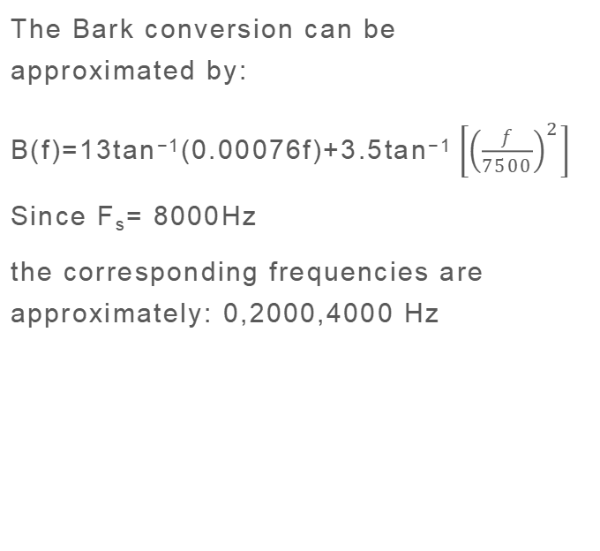
Step 7: Convert frequencies to Bark scale
The Bark conversion can be approximated by:
B(f)=13tan⁻¹(0.00076f)+3.5tan⁻¹ $\left[{\left(\frac{f}{7500}\right)}^{2}\right]$
Since F_{s}= 8000Hz
the corresponding frequencies are approximately: 0,2000,4000 Hz
B(2000) ≈13.1 Bark
B(4000)≈19.0 Bark
Thus the spectrum is represented on a perceptually motivated frequency scale.​

Slide 10
Step 8: Bark auditory filtering
In an actual PLP implementation, the LPC spectrum is passed through a critical-band filterbank.
To demonstrate the auditory weighting, suppose the simplified Bark-filter responses are:
W_{B} =[0.80,1.00,0.70]
P_{B}​=P×W_{B}​
P_{B​}(1)=113.16(0.8)=90.53
P_{B}​(2)=12.41(1)=12.41
P_{B}​(3)=4.53(0.7)=3.17

Slide 11
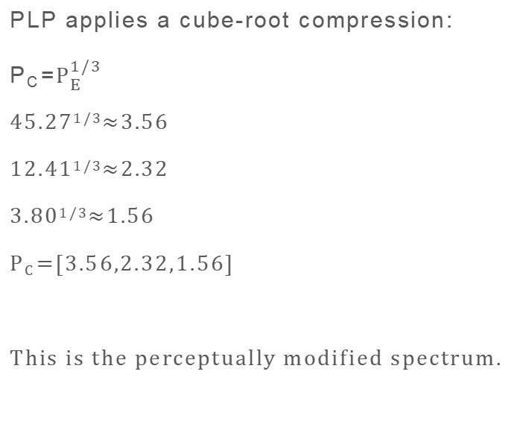
Step 9: Equal-loudness weighting
Step 10: Loudness compression
let the equal-loudness weights be:
W_{E}​=[0.50,1.00,1.20]
P_{E}​=P_{B}​×W_{E​}
Low frequency: 90.53(0.50) =45.27
Middle frequency: 12.41(1) =12.41
High frequency : 3.17(1.20) =3.80
PLP applies a cube-root compression:
P_{C}​=$P_{E}^{1/3}$
45.27^{1/3}≈3.56
12.41^{1/3}≈2.32
3.80^{1/3}≈1.56
P_{C}​=[3.56,2.32,1.56]​
This is the perceptually modified spectrum.

Slide 12
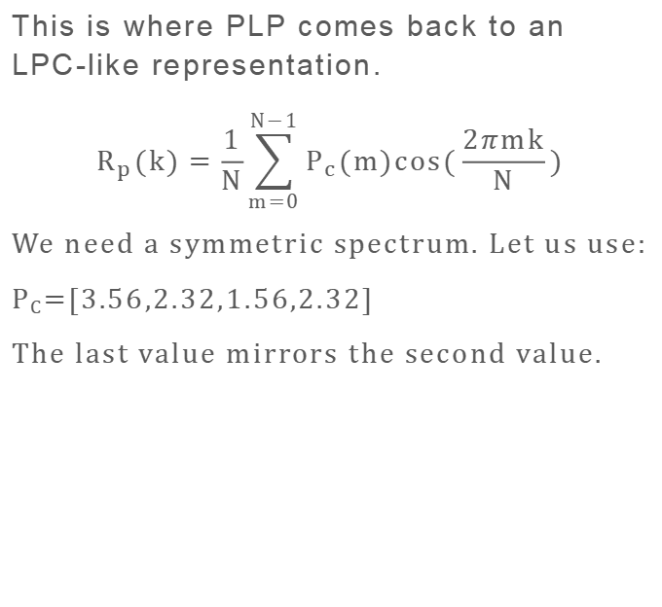
Step 11: Convert perceptual spectrum back to autocorrelation
This is where PLP comes back to an LPC-like representation.
$$R_{p}(k)=\frac{1}{N}\sum_{m=0}^{N−1}{P_{c}(m)cos(\frac{2πmk}{N})}$$
We need a symmetric spectrum. Let us use:
P_{C}=[3.56,2.32,1.56,2.32]
The last value mirrors the second value.
Calculate R_{p}(0)
R_{p}​(0)=1/4​(3.56+2.32+1.56+2.32)=2.44
R_{p}​(1)=0.50​
R_{p}​(2)=0.12

Slide 13
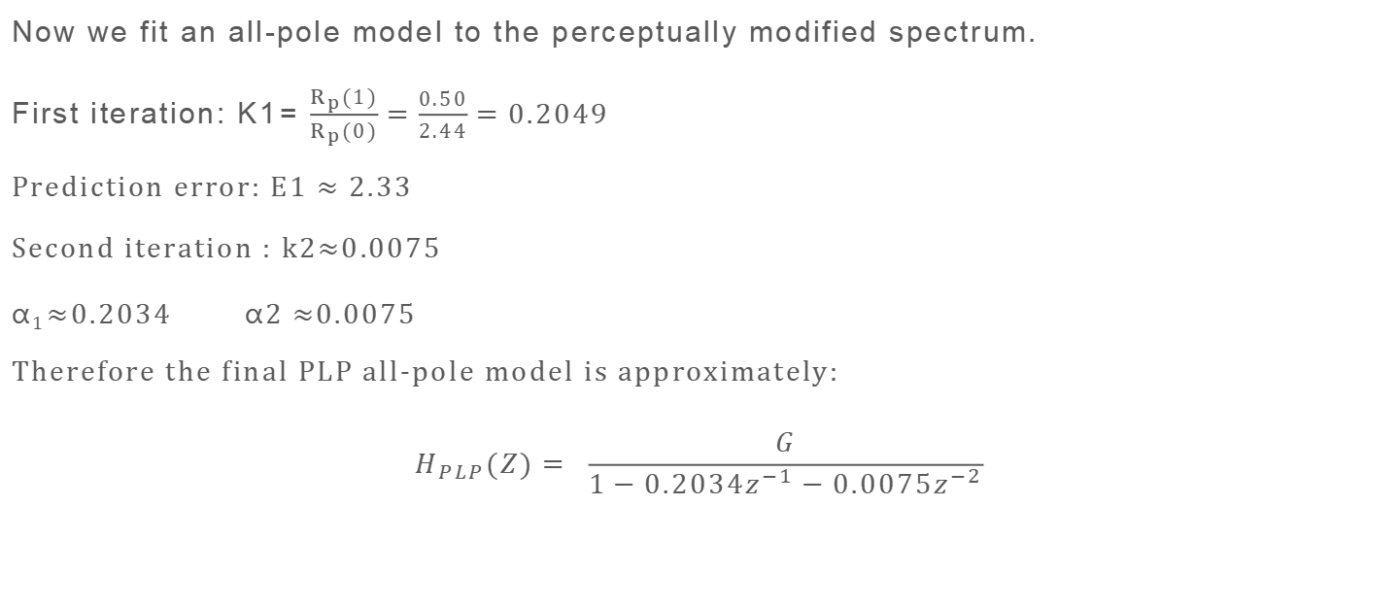
Step 12: All-pole approximation using Levinson–Durbin
Now we fit an all-pole model to the perceptually modified spectrum.
First iteration: K1​= $\frac{R_{p}(1)}{R_{p}(0)}=\frac{0.50}{2.44}=0.2049$
Prediction error: E1 $≈2.33$
Second iteration : k2$≈$0.0075
α₁​≈0.2034​ α2 ≈0.0075
Therefore the final PLP all-pole model is approximately:
$$H_{PLP}(Z)= \frac{G}{1−0.2034z^{−1}−0.0075z^{−2}}$$

Slide 14
Two Levinson–Durbin operations
Stage | Input | Output
First LD | Speech autocorrelation | LPC coefficients
PLP processing | LPC spectrum → Bark → equal-loudness → compression | Perceptual spectrum
Second LD / all-pole fitting | Perceptual-spectrum autocorrelation | PLP all-pole coefficients

